Slide 1
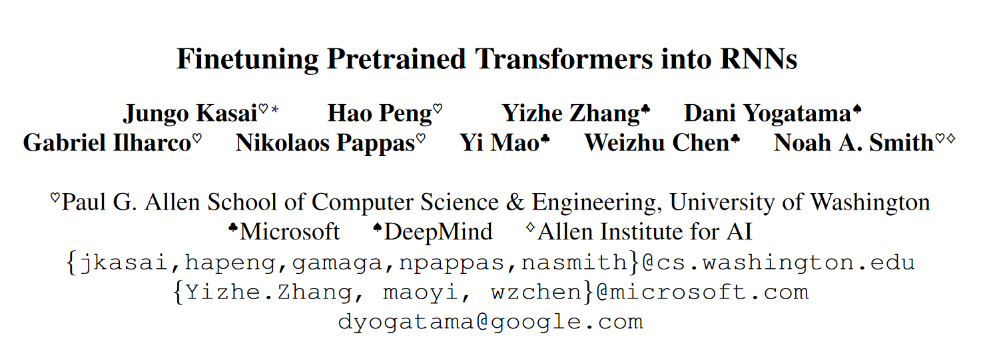

Slide 2
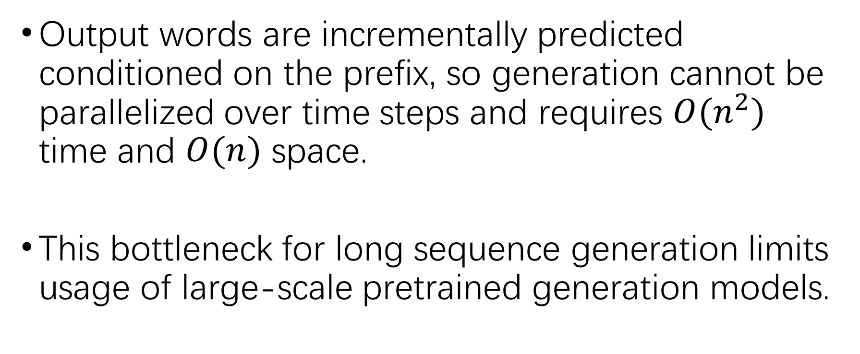
What’s wrong with transformer
Output words are incrementally predicted conditioned on the prefix, so generation cannot be parallelized over time steps and requires $O(n^{2})$ time and $O(n)$ space.
This bottleneck for long sequence generation limits usage of large-scale pretrained generation models.

Slide 3
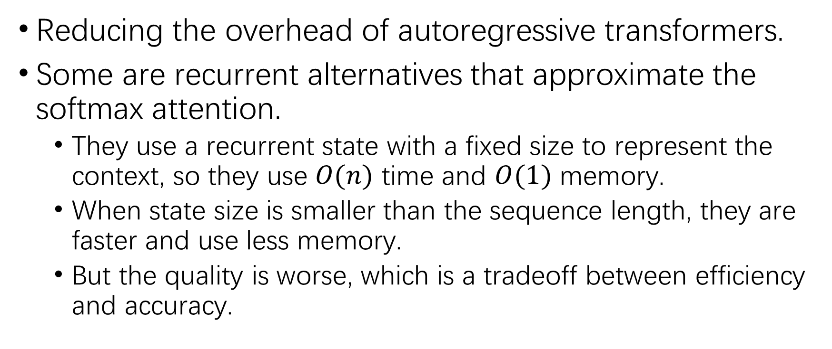
What recent works did
Reducing the overhead of autoregressive transformers.
Some are recurrent alternatives that approximate the softmax attention.
They use a recurrent state with a fixed size to represent the context, so they use $O(n)$ time and $O(1)$ memory.
When state size is smaller than the sequence length, they are faster and use less memory.
But the quality is worse, which is a tradeoff between efficiency and accuracy.

Slide 4
What this work does
We improves the tradeoff by a conversion approach: convert a pretrained transformer into an RNN instead of training from scratch.
Experiments on LM and NMT show that the conversion can be done while retaining high accuracy.
It requires much less GPU time than training randomly-initialized models from scratch.

Slide 5
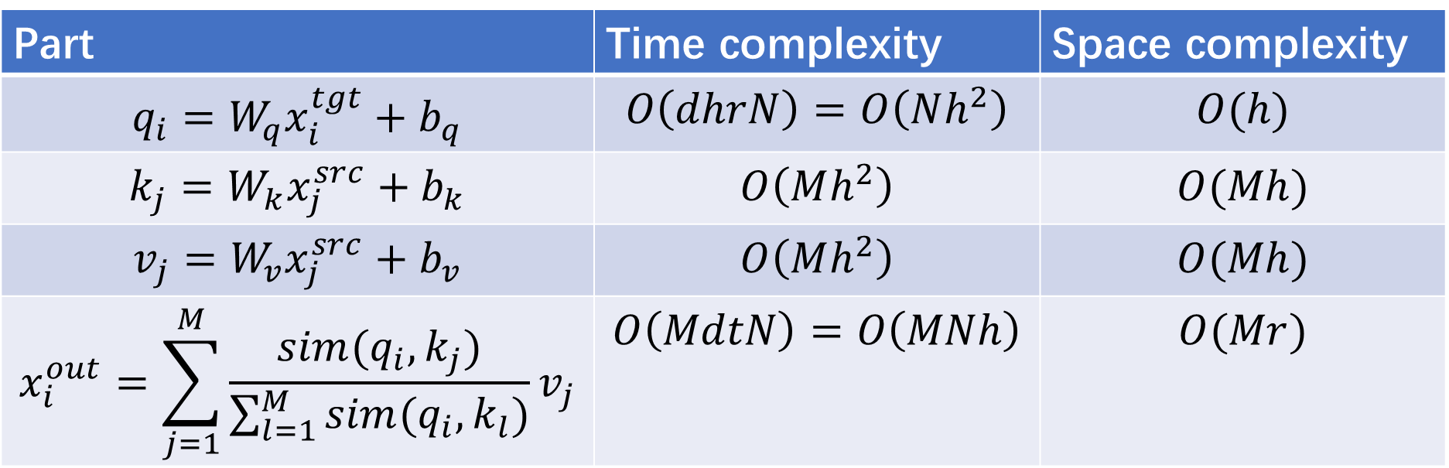

Performance of transformer when predicting
Source length $M$, target length $N$.
$r$ attention heads of $d$ dimensions, and $h=dr$.
Part | Time complexity | Space complexity
$$q_{i}=W_{q}x_{i}^{tgt}+b_{q}$$ | $$O\left(dhrN\right)=O\left(Nh^{2}\right)$$ | $$O(h)$$
$$k_{j}=W_{k}x_{j}^{src}+b_{k}$$ | $$O\left(Mh^{2}\right)$$ | $$O(Mh)$$
$$v_{j}=W_{v}x_{j}^{src}+b_{v}$$ | $$O\left(Mh^{2}\right)$$ | $$O(Mh)$$
$$x_{i}^{out}=\sum_{j=1}^{M}{\frac{sim(q_{i},k_{j})}{\sum_{l=1}^{M}{sim(q_{i},k_{l})}}v_{j}}$$ | $$O\left(MdtN\right)=O\left(MNh\right)$$ | $$O(Mr)$$

Slide 6
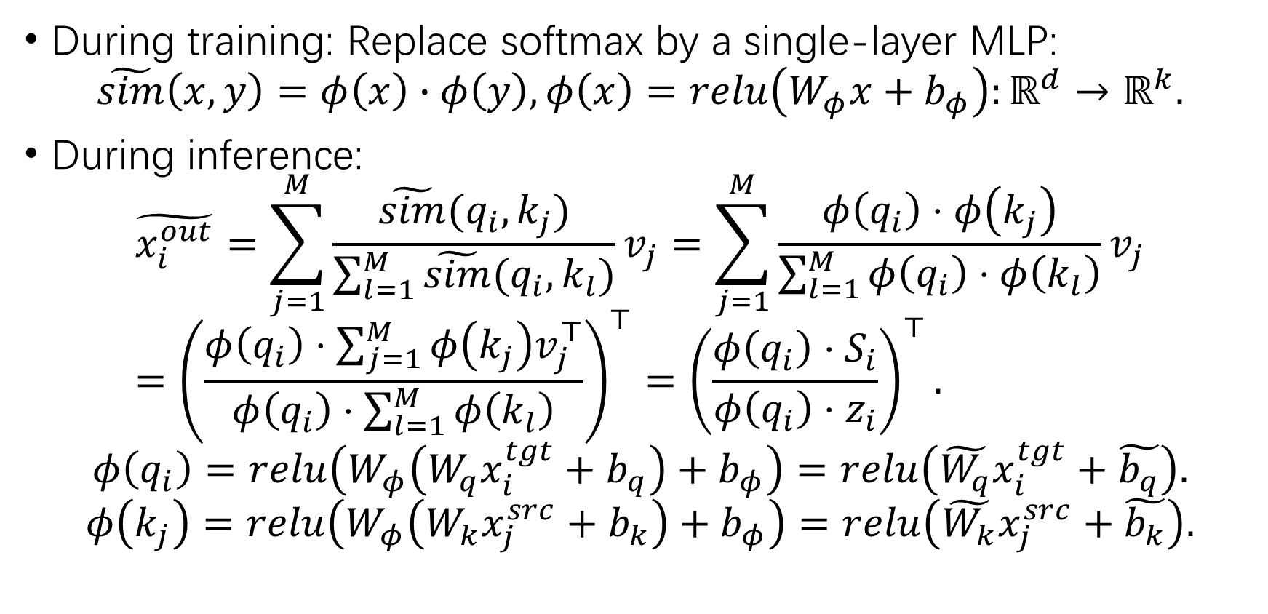
How to convert a transformer into an RNN
During training: Replace softmax by a single-layer MLP:
$$\tilde{sim}\left(x,y\right)=φ\left(x\right)∙φ\left(y\right), φ\left(x\right)=relu\left(W_{φ}x+b_{φ}\right):ℝ^{d}→ℝ^{k}.$$
During inference:
$$\tilde{x_{i}^{out}}=\sum_{j=1}^{M}{\frac{\tilde{sim}(q_{i},k_{j})}{\sum_{l=1}^{M}{\tilde{sim}(q_{i},k_{l})}}v_{j}}=\sum_{j=1}^{M}{\frac{φ\left(q_{i}\right)⋅φ\left(k_{j}\right)}{\sum_{l=1}^{M}{φ\left(q_{i}\right)⋅φ\left(k_{l}\right)}}v_{j}}={\left(\frac{φ\left(q_{i}\right)⋅\sum_{j=1}^{M}{φ\left(k_{j}\right)v_{j}^{⊤}}}{φ\left(q_{i}\right)⋅\sum_{l=1}^{M}{φ\left(k_{l}\right)}}\right)}^{⊤}={\left(\frac{φ\left(q_{i}\right)⋅S_{i}}{φ\left(q_{i}\right)⋅z_{i}}\right)}^{⊤}.$$
$$φ\left(q_{i}\right)=relu\left(W_{φ}\left(W_{q}x_{i}^{tgt}+b_{q}\right)+b_{φ}\right)=relu\left(\tilde{W_{q}}x_{i}^{tgt}+\tilde{b_{q}}\right).$$
$$φ\left(k_{j}\right)=relu\left(W_{φ}\left(W_{k}x_{j}^{src}+b_{k}\right)+b_{φ}\right)=relu\left(\tilde{W_{k}}x_{j}^{src}+\tilde{b_{k}}\right).$$

Slide 7
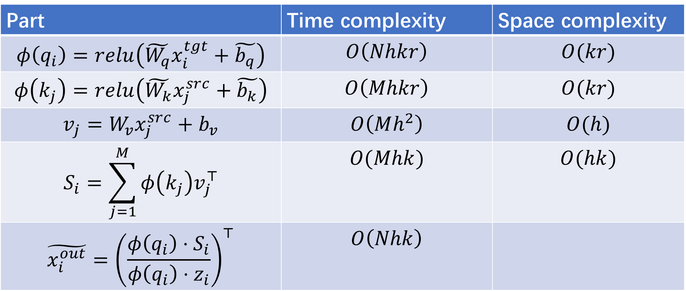
Performance of this work when predicting
Part | Time complexity | Space complexity
$$φ\left(q_{i}\right)=relu\left(\tilde{W_{q}}x_{i}^{tgt}+\tilde{b_{q}}\right)$$ | $$O\left(Nhkr\right)$$ | $$O(kr)$$
$$φ\left(k_{j}\right)=relu\left(\tilde{W_{k}}x_{j}^{src}+\tilde{b_{k}}\right)$$ | $$O\left(Mhkr\right)$$ | $$O(kr)$$
$$v_{j}=W_{v}x_{j}^{src}+b_{v}$$ | $$O\left(Mh^{2}\right)$$ | $$O(h)$$
$$S_{i}=\sum_{j=1}^{M}{φ\left(k_{j}\right)v_{j}^{⊤}}$$ | $$O(Mhk)$$ | $$O(hk)$$
$$\tilde{x_{i}^{out}}={\left(\frac{φ\left(q_{i}\right)⋅S_{i}}{φ\left(q_{i}\right)⋅z_{i}}\right)}^{⊤}$$ | $$O\left(Nhk\right)$$

Slide 8
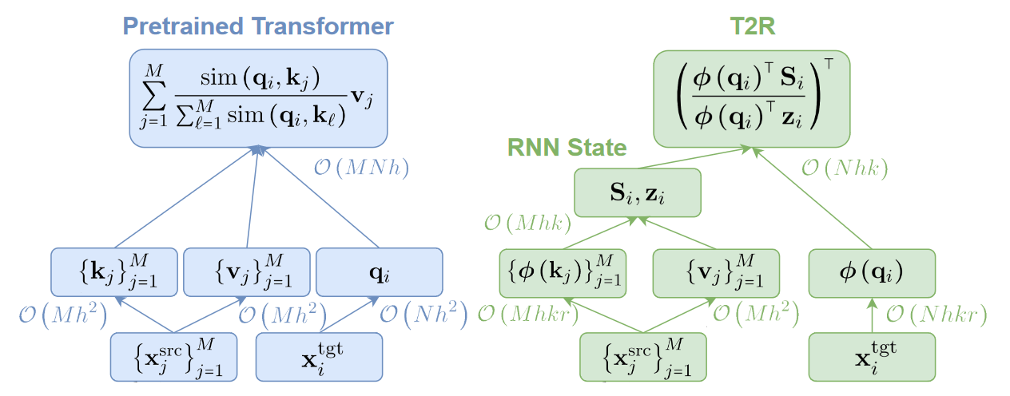
Time complexity comparison

Slide 9
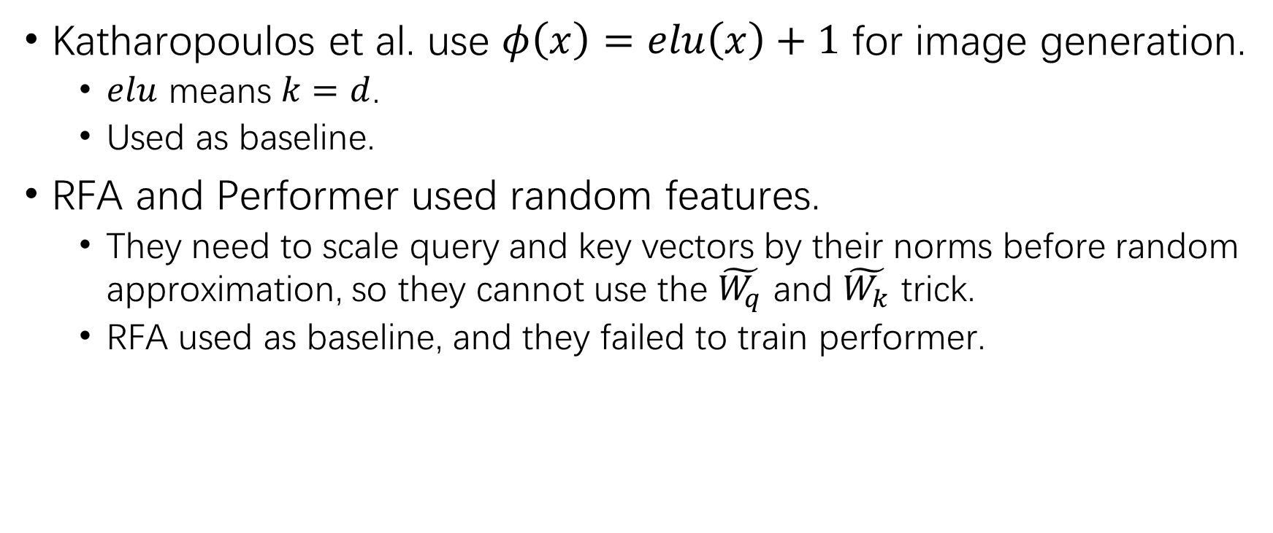

Other choices of $φ$
Katharopoulos et al. use $φ\left(x\right)=elu\left(x\right)+1$ for image generation.
$elu$ means $k=d$.
Used as baseline.
RFA and Performer used random features.
They need to scale query and key vectors by their norms before random approximation, so they cannot use the $\tilde{W_{q}}$ and $\tilde{W_{k}}$ trick.
RFA used as baseline, and they failed to train performer.

Slide 10
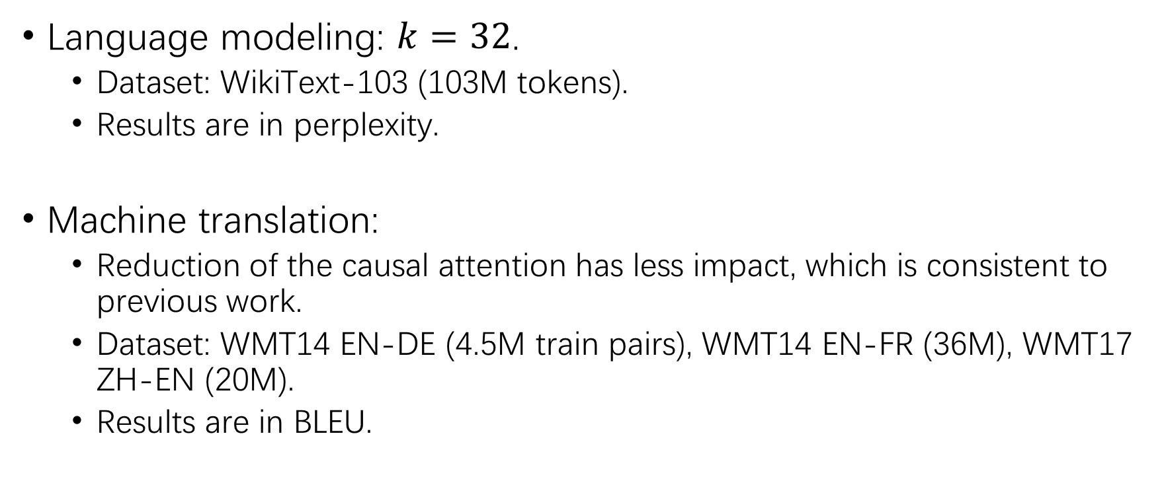
Experiments – Setup and Implementations
Language modeling: $k=32$.
Dataset: WikiText-103 (103M tokens).
Results are in perplexity.
Machine translation:
Reduction of the causal attention has less impact, which is consistent to previous work.
Dataset: WMT14 EN-DE (4.5M train pairs), WMT14 EN-FR (36M), WMT17 ZH-EN (20M).
Results are in BLEU.

Slide 11
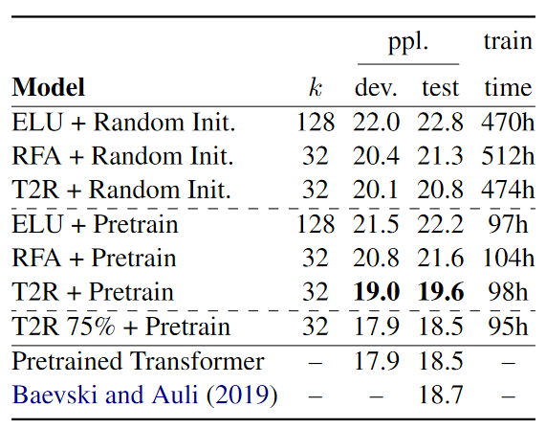
Results – Language Modeling
T2R 75%:
every fourth layer from the top is kept as the original transformer layer, a middle ground between efficiency and accuracy.

Slide 12
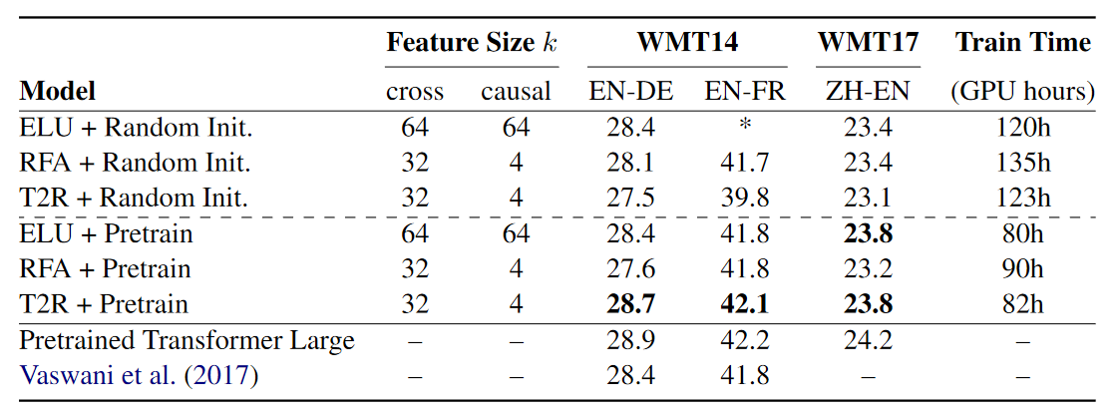
Results – Machine Translation

Slide 13
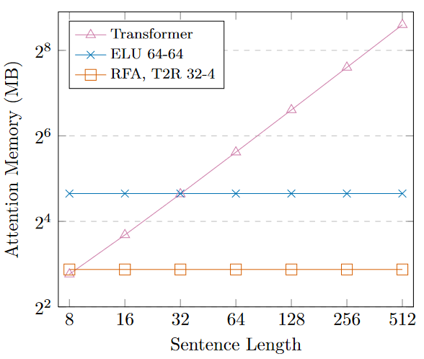
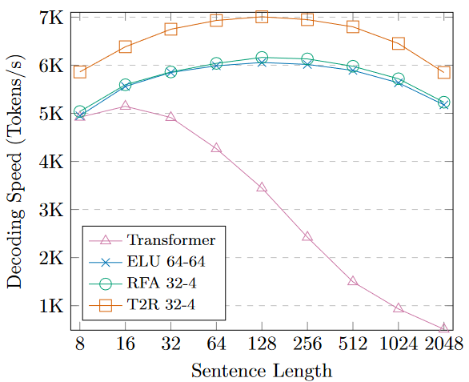
Results – Machine Translation

Slide 14
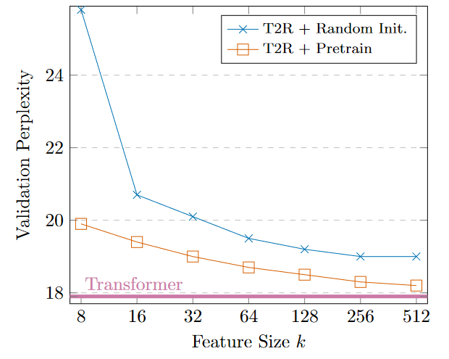

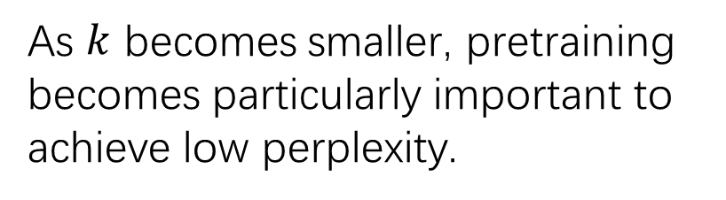
Ablation study – $k$ and pretraining
As $k$ becomes smaller, pretraining becomes particularly important to achieve low perplexity.

Slide 15
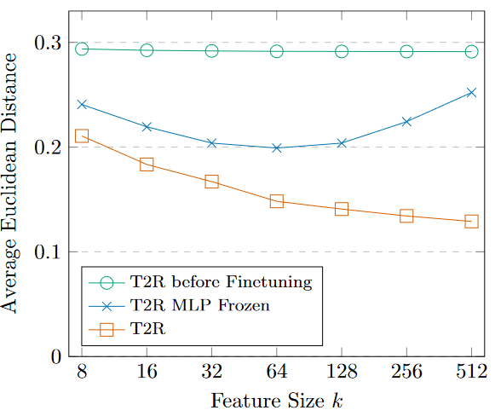
Ablation study – Attention Distribution
T2R MLP Frozen: a T2R model finetuned with the MLP parameters frozen.
This figure shows average Euclidean distance of T2R models from transformer attention weights.
Funetuning induces much more similar attention distributions.

Slide 16
Conclusion
T2R: a method that converts a pretrained transformer to a recurrent neural network that reduces time and memory cost during inference time.
It produces an improved tradeoff between efficiency and accuracy.

